Slide 1

CASE STUDY 1
By-
Jinal Jain
Manasee Ghodsey
Rushikesh Naidu
Mihir Sawant
Umesh Nair

Slide 2
Apple Inc. and iPhone X is chosen as the focus for analysis considering the timing of its launch and the hype of the product which brings up a huge amount of data on Social Media (Twitter in our Case Study).

Slide 3
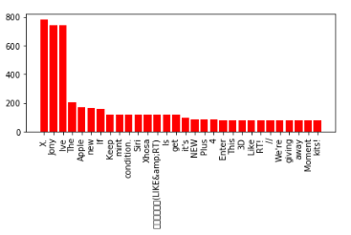
w
What’s trending ?
Popular Words

Slide 4
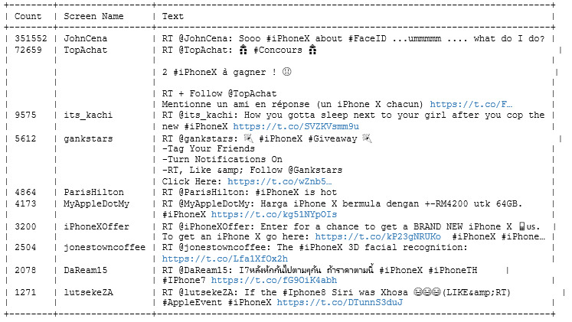
Most Popular Tweets

Slide 5
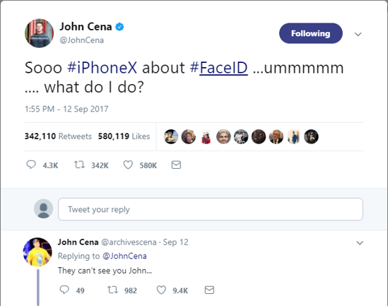
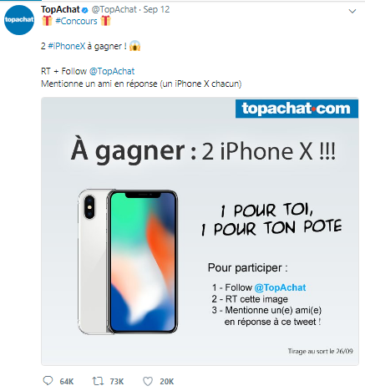

Slide 6
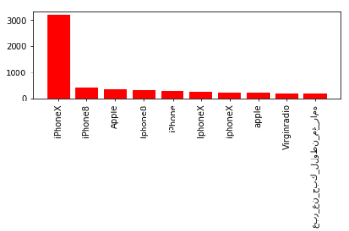
Popular Hashtags

Slide 7
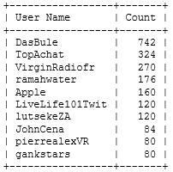
Top user mentions

Slide 8
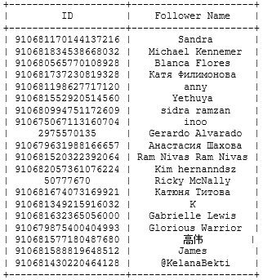
Tim Cook’s twitter
Top Followers

Slide 9
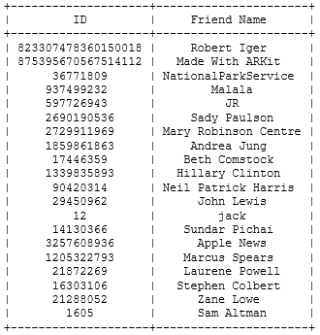
Top Friends

Slide 10

Mutual Friends and Followers
There are no mutual friends between the followers and friends for Tim Cook

Slide 11
Apple Inc. launched the Apple iPhone 8 and iPhone X on 12th September 2017
However, Apple plans to ship the first batch of iPhone X on 2nd November 2017
The objective of this case study is to design a roadmap for Apple Inc. from September to November by analyzing data from Twitter.

Slide 12
What should apple do to amplify the sales of iPhoneX ?
October – November 2017
iPath

Slide 13
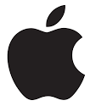
Objective
How can maintain the RAGE
Turn around customers and Amplify sales

Slide 14

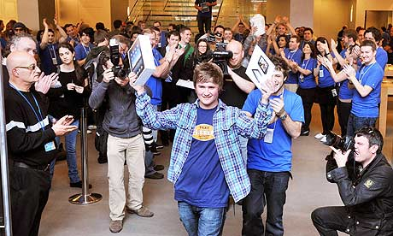

Demographics of Population
Indecisive
Loyalist
Skeptic

Slide 15
@iTunes
@AppleSupport
@tim_cook
Where is @apple ?
@AppleNews
@AppStore
@AppleMusic
@iBooks
@ApplePodcasts

Slide 16
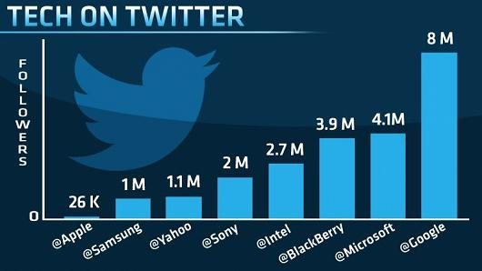
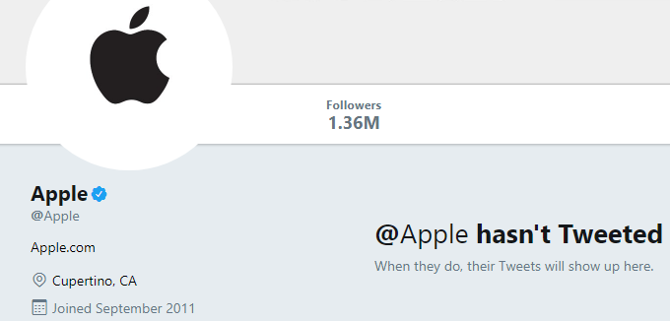
2014
2017
Reference: https://www.cnbc.com/2014/02/21/why-isnt-apple-on-twitter.html
https://twitter.com/apple?lang=en

Slide 17
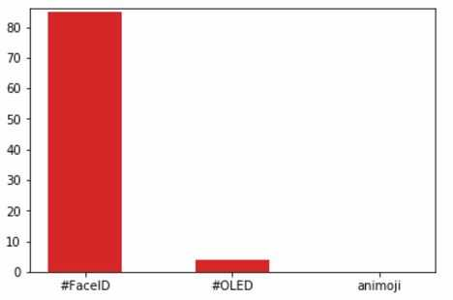
Features of iPhoneX

Slide 18

#FaceID

Slide 19
What should Apple do ?
Collaboration
Start Tweeting
Subtly show how “FaceID WORKS”
Promote features != “FaceID”

Slide 20
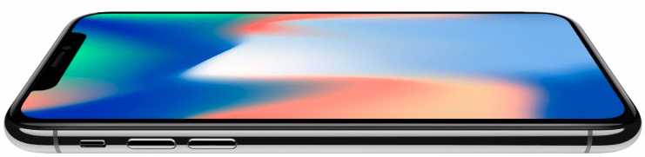
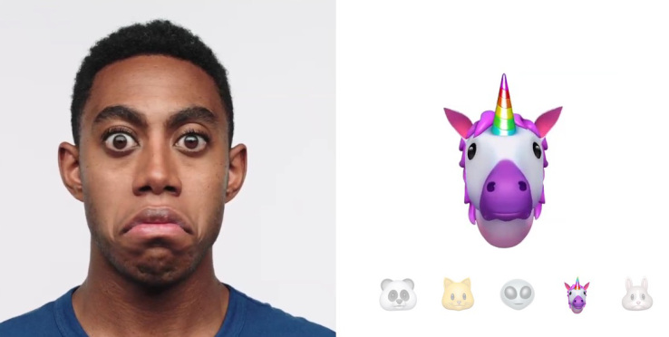
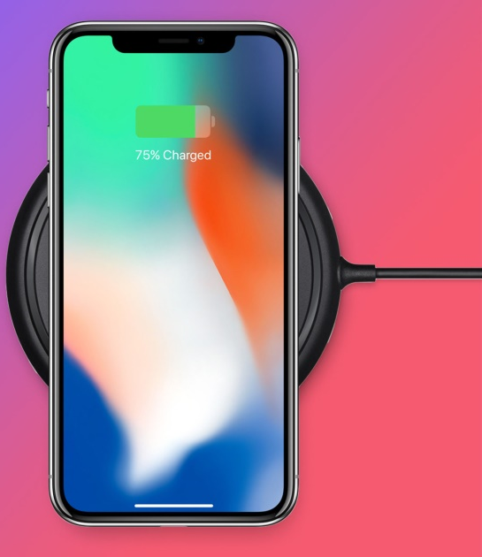
Not just #FaceID
OLED Display
Animoji
Wireless charging

Slide 21
QUESTIONS ?

Slide 22
THAT’S ALL FOLKS!

